Slide 1

APEX INSTITUTE OF TECHNOLOGY
DEPARTMENT OF COMPUTER SCIENCE & ENGINEERING
Database Management System (22CSH-243)
Faculty: Ms. Shaveta Jain(E13464)
Data Models
DISCOVER . LEARN . EMPOWER

Slide 2
DBMS: Course Objectives
COURSE OBJECTIVES
The Course aims to:
Understand database system concepts and design databases for different applications and to acquire the knowledge on DBMS and RDBMS.
Implement and understand different types of DDL, DML and DCL statements.
Understand transaction concepts related to databases and recovery/backup techniques required for the proper storage of data.

Slide 3
COURSE OUTCOMES
On completion of this course, the students shall be able to:-
CO2 | Design database for an organization using relational model

Slide 4
Unit-1 Syllabus
Unit-1 | Introduction to Databases and Relational Algebra
Overview of Databases: | Database concepts, DBMS, Data Base System Architecture (Three Level ANSI-SPARC Architecture), Advantages and Disadvantages of DBMS, Data Independence, DBA and Responsibilities of DBA, Relational Data Structure, Keys, Relations, Attributes, Schema and Instances, Referential integrity, Entity integrity.
Data Models: | Relational Model, Network Model, Hierarchical Model, ER Model: Design, issues, Mapping constraints, ER diagram, Comparison of Models
Relational Algebra & Relational Calculus: | Introduction, Syntax, Semantics, Additional operators, Grouping and Ungrouping, Relational comparisons, Tuple Calculus, Domain Calculus, Calculus Vs Algebra, Computational capabilities

Slide 5
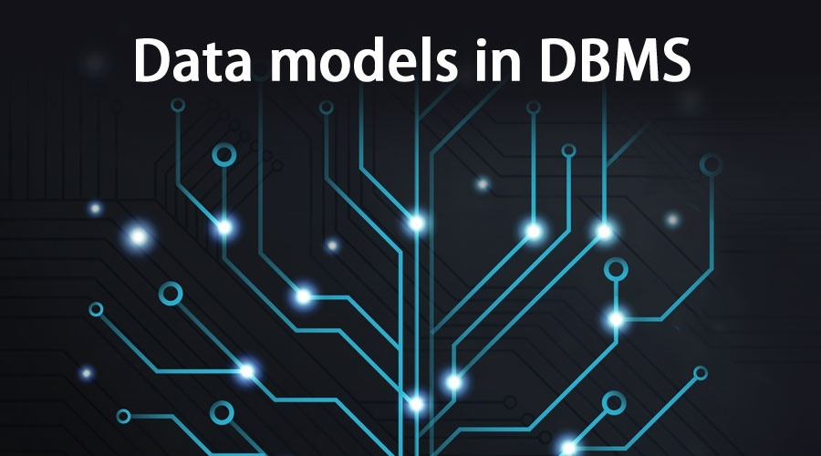
DATA MODELS

Slide 6
What is Data Model
A data model is an abstract model that organizes elements of data
It standardizes how they relate to one another and to the properties of real-world entities.
Data models define how the logical structure of a database is modeled.
Data Models are fundamental entities to introduce abstraction in a DBMS.
Data models define how data is connected to each other and how they are processed and stored inside the system.

Slide 7
Need
To aid in the development of a sound database design that does not allow anomalies or inconsistencies
Goal: to create database tables that do not contain duplicate data values that can become inconsistent

Slide 8
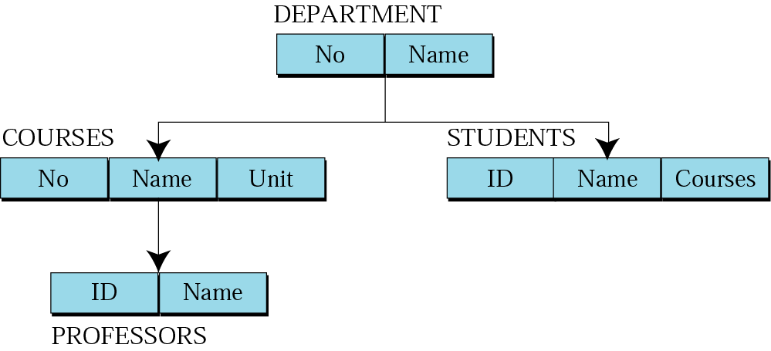
Hierarchical Model
slideplayer.com

Slide 9
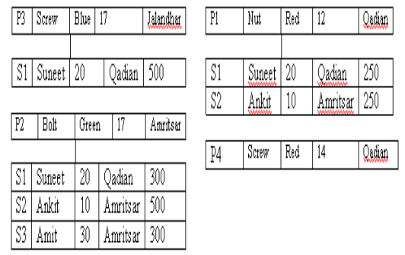
Equivalent model
Slideplayer.com

Slide 10
Cont...
Advantages
Many of the hierarchical data model’s features formed the foundation for current data models
Its database application advantages are replicated, implemented in a different form, in current database environments
Generated a large installed (mainframe) base, created a pool of programmers who developed numerous tried-and-true business applications
Disadvantages
Complex to implement
Difficult to manage
Lacks structural independence
Implementation limitations
Lack of standards

Slide 11
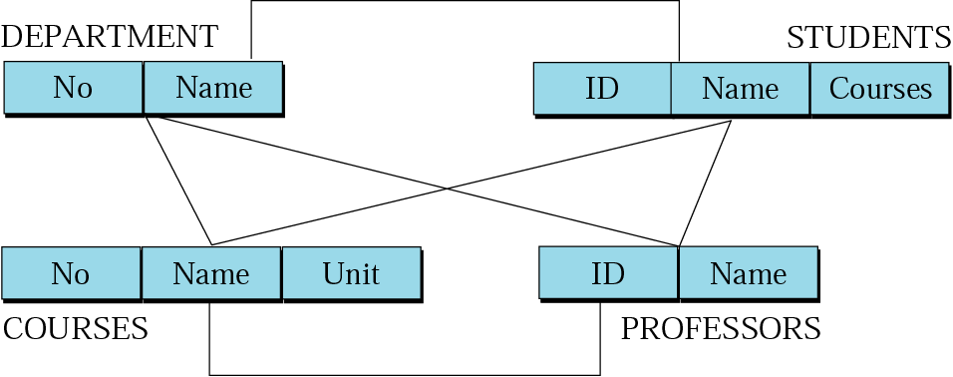
Network Model
slideplayer.com

Slide 12
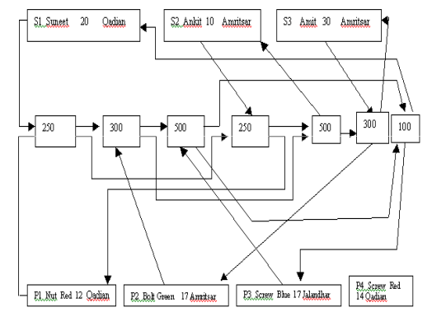
Equivalent
slideplayer.com

Slide 13
Cont...
Advantages
Represent complex data relationships more effectively
Improve database performance
Impose a database standard
Disadvantages
Too cumbersome
The lack of ad hoc query capability put heavy pressure on programmers
Any structural change in the database could produce havoc in all application programs that drew data from the database
Many database old-timers can recall the interminable information delays

Slide 14
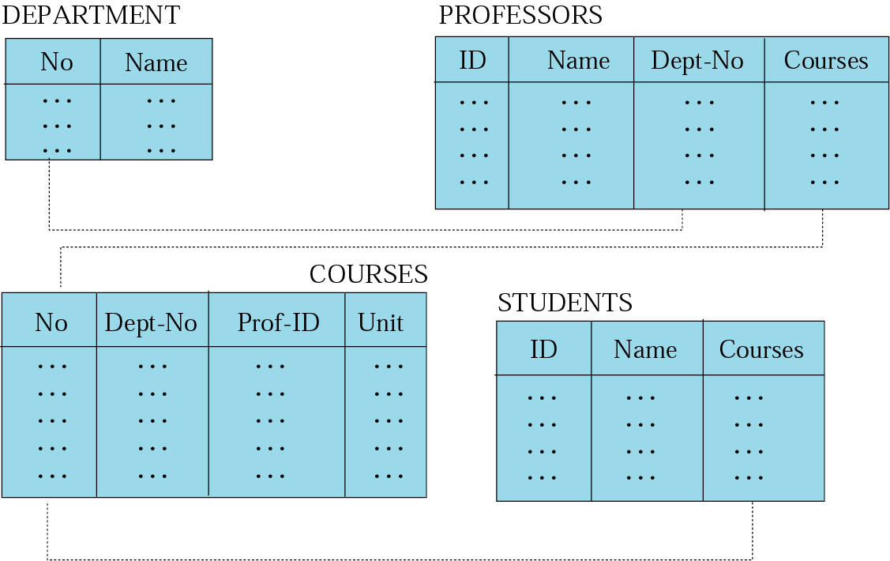
Relational Model
Slideplayer.com

Slide 15
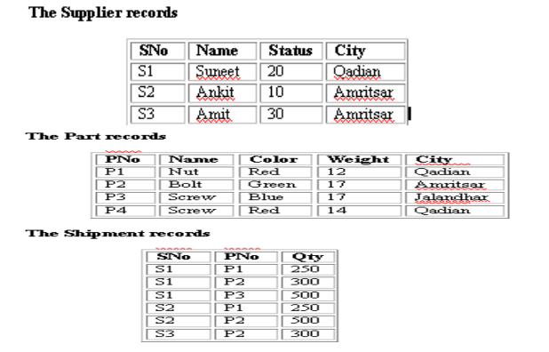
Equivalent model

Slide 16
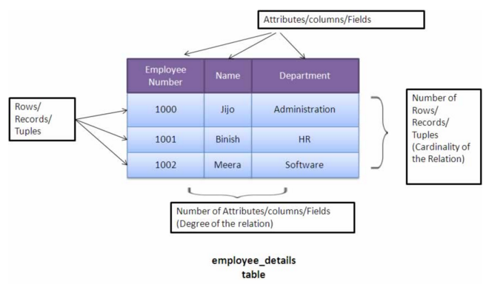
Relational Database
A database whose logical organization is based on relational data model is a Relational Database
Quantumcomputingtech.blogspot.com

Slide 17
Relational Model
The main highlights of this model are −
Data is stored in tables called relations.
Relations can be normalized.
In normalized relations, values saved are atomic values.
Each row in a relation contains a unique value.
Each column in a relation contains values from a same domain.

Slide 18
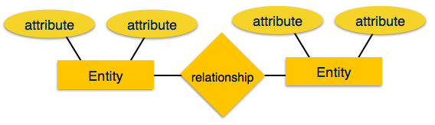
Entity- Relationship Model
Entity-Relationship (ER) Model is based on the notion of real-world entities and relationships among them. While formulating real-world scenario into the database model, the ER Model creates entity set, relationship set, general attributes and constraints.
ER Model is best used for the conceptual design of a database.
tutorialspoint.com

Slide 19
Schema vs Instances
Database Schema: The description of a database. Includes descriptions of the database structure and the constraints that should hold on the database.
Schema Diagram: A diagrammatic display of (some aspects of) a database schema.
Database Instance: The actual data stored in a database at a particular moment in time. Also called database state (or occurrence).

Slide 20
DBMS Schema vs DBMS State
Database State: Refers to the content of a database at a moment in time.
Initial Database State: Refers to the database when it is loaded
Valid State: A state that satisfies the structure and constraints of the database.
Distinction
The database schema changes very infrequently. The database state changes every time the database is updated.
Schema is also called intension, whereas state is called extension.

Slide 21
Summary
A Data Model is a precise description of the data content in a system.
Data Models are required to aid in the development of a sound database design that does not allow anomalies or inconsistencies where the basic goal is to create database tables that do not contain duplicate data values that can become inconsistent.

Slide 22
FAQs
What are Data Models?
What is Schema
What are instances.
What is the difference between DBMS Schema and DBMS State.
Why there is need for Data models?
How many types of Data Models we Have?
What is hierarichal Data Model?

Slide 23
References
RamezElmasri and Shamkant B. Navathe, “Fundamentals of Database System”, The Benjamin / Cummings Publishing Co.
Korth and Silberschatz Abraham, “Database System Concepts”, McGraw Hall.
C.J.Date, “An Introduction to Database Systems”, Addison Wesley.
Thomas M. Connolly, Carolyn & E. Begg, “Database Systems: A Practical Approach to Design, Implementation and Management”, 5/E, University of Paisley, Addison-Wesley.

Slide 24
THANK YOU
For queries
Email: shaveta.e13464@cumail.in

